Slide 1
Java Collections
Object Oriented Concept

Slide 2
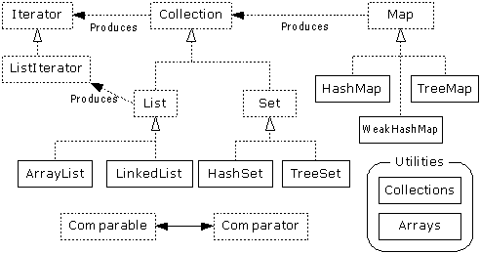
Collections Framework Diagram
Interfaces, Implementations, and Algorithms
From Thinking in Java, page 462

Slide 3
Collection Interface
Defines fundamental methods
int size();
boolean isEmpty();
boolean contains(Object element);
boolean add(Object element); // Optional
boolean remove(Object element); // Optional
Iterator iterator();
These methods are enough to define the basic behavior of a collection
Provides an Iterator to step through the elements in the Collection

Slide 4
Iterator Interface
Defines three fundamental methods
Object next()
boolean hasNext()
void remove()
These three methods provide access to the contents of the collection
An Iterator knows position within collection
Each call to next() “reads” an element from the collection
Then you can use it or remove it

Slide 5
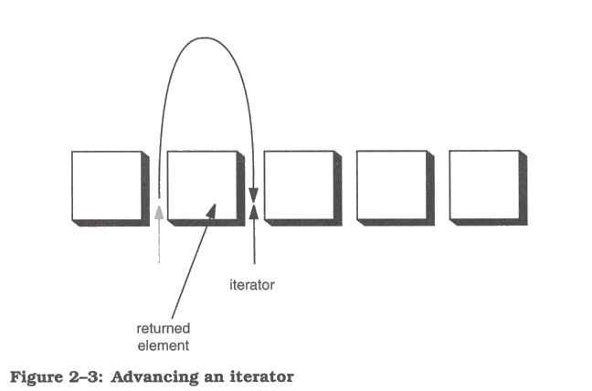
Iterator Position

Slide 6
Example - SimpleCollection
public class SimpleCollection {
public static void main(String[] args) {
Collection c;
c = new ArrayList();
System.out.println(c.getClass().getName());
for (int i=1; i <= 10; i++) {
c.add(i + " * " + i + " = "+i*i);
}
Iterator iter = c.iterator();
while (iter.hasNext())
System.out.println(iter.next());
}
}

Slide 7
List Interface Context
Collection
List

Slide 8
List Interface
The List interface adds the notion of order to a collection
The user of a list has control over where an element is added in the collection
Lists typically allow duplicate elements
Provides a ListIterator to step through the elements in the list.

Slide 9
ListIterator Interface
Extends the Iterator interface
Defines three fundamental methods
void add(Object o) - before current position
boolean hasPrevious()
Object previous()
The addition of these three methods defines the basic behavior of an ordered list
A ListIterator knows position within list

Slide 10
Iterator Position - next(), previous()

Slide 11
ArrayList and LinkedList Context
Collection
List
ArrayList
LinkedList

Slide 12
List Implementations
ArrayList
low cost random access
high cost insert and delete
array that resizes if need be
LinkedList
sequential access
low cost insert and delete
high cost random access

Slide 13
ArrayList overview
Constant time positional access (it’s an array)
One tuning parameter, the initial capacity
public ArrayList(int initialCapacity) {
super();
if (initialCapacity < 0)
throw new IllegalArgumentException(
"Illegal Capacity: "+initialCapacity);
this.elementData = new Object[initialCapacity];
}

Slide 14
ArrayList methods
The indexed get and set methods of the List interface are appropriate to use since ArrayLists are backed by an array
Object get(int index)
Object set(int index, Object element)
Indexed add and remove are provided, but can be costly if used frequently
void add(int index, Object element)
Object remove(int index)
May want to resize in one shot if adding many elements
void ensureCapacity(int minCapacity)

Slide 15
Set Interface Context
Collection
Set

Slide 16
Set Interface
Same methods as Collection
different contract - no duplicate entries
Defines two fundamental methods
boolean add(Object o) - reject duplicates
Iterator iterator()
Provides an Iterator to step through the elements in the Set
No guaranteed order in the basic Set interface
There is a SortedSet interface that extends Set

Slide 17
HashSet and TreeSet Context
Collection
Set
HashSet
TreeSet

Slide 18
HashSet
Find and add elements very quickly
uses hashing implementation in HashMap
Hashing uses an array of linked lists
The hashCode() is used to index into the array
Then equals() is used to determine if element is in the (short) list of elements at that index
No order imposed on elements
The hashCode() method and the equals() method must be compatible
if two objects are equal, they must have the same hashCode() value

Slide 19
TreeSet
Elements can be inserted in any order
The TreeSet stores them in order
Red-Black Trees out of Cormen-Leiserson-Rivest
An iterator always presents them in order
Default order is defined by natural order
objects implement the Comparable interface
TreeSet uses compareTo(Object o) to sort
Can use a different Comparator
provide Comparator to the TreeSet constructor

Slide 20
Map Interface Context
Map

Slide 21
Map Interface
Stores key/value pairs
Maps from the key to the value
Keys are unique
a single key only appears once in the Map
a key can map to only one value
Values do not have to be unique

Slide 22
Map methods
Object put(Object key, Object value)
Object get(Object key)
Object remove(Object key)
boolean containsKey(Object key)
boolean containsValue(Object value)
int size()
boolean isEmpty()

Slide 23
Map views
A means of iterating over the keys and values in a Map
Set keySet()
returns the Set of keys contained in the Map
Collection values()
returns the Collection of values contained in the Map. This Collection is not a Set, as multiple keys can map to the same value.
Set entrySet()
returns the Set of key-value pairs contained in the Map. The Map interface provides a small nested interface called Map.Entry that is the type of the elements in this Set.

Slide 24
HashMap and TreeMap Context
Map
HashMap
TreeMap

Slide 25
HashMap and TreeMap
HashMap
The keys are a set - unique, unordered
Fast
TreeMap
The keys are a set - unique, ordered
Same options for ordering as a TreeSet
Natural order (Comparable, compareTo(Object))
Special order (Comparator, compare(Object, Object))

Slide 26
HashMap and TreeMap
HashMap
HashMap can contain one null key.
HashMap maintains no order.
TreeMap
TreeMap can not contain any null key.
TreeMap maintains ascending order.

Slide 27
HashMap
{
HashMap<Integer,String> hm=new HashMap<Integer,String>();
hm.put(100,“Tahil");
hm.put(102,“Rifad");
hm.put(101,“Jubayer");
for(Map.Entry m:hm.entrySet()){
System.out.println(m.getKey()+" "+m.getValue());
}
If ( hm.containsKey (102))
System.out.println(hm.get(102));
hm.remove(102);
}

Slide 28
Bulk Operations
In addition to the basic operations, a Collection may provide “bulk” operations
boolean containsAll(Collection c);
boolean addAll(Collection c); // Optional
boolean removeAll(Collection c); // Optional
boolean retainAll(Collection c); // Optional
void clear(); // Optional
Object[] toArray();
Object[] toArray(Object a[]);

Slide 29
HashMap and Hashtable
HashMap is non synchronized. It is not-thread safe
HashMap allows one null key and multiple null values.
HashMap is fast.
HashMap is traversed by Iterator.
HashMap inherits AbstractMap class.
Hashtable is synchronized. It is thread-safe
Hashtable doesn't allow any null key or value.
Hashtable is sl
Hashtable is traversed by Enumerator and Iterator.ow.
Hashtable inherits Dictionary class.

